Slide 1
ICANN | FY14 Draft Operating Plan and Budget

Slide 2
Table of Contents
Introduction
Organizational Transformation
Planning Process Overview
FY13 Forecast Update
Statement of Activities
Revenues
Variance Analysis
FY14 Draft Operating Plan and Budget
Financial Data
Statement of Activities
Revenues
Variance Analysis
Headcount
Management Delivery – AtTask
Community Support Requests
New gTLD Program
Appendix

Slide 3
Overview
This FY14 Draft Operating Plan and Budget sets forth the proposed focus of efforts and organizational commitments for the next fiscal year.
This proposal will be modified as a result of feedback from the community and ICANN’s Board, and will be considered for adoption in June 2013.

Slide 4
Background
This document provides context for the budget development process and qualitative and quantitative descriptions of FY14 operational activities.
During the current fiscal year, there have been significant process improvements that have impacted the organization and as a result, the current and future year planning processes.
This document will provide an overview of those changes, with a description of what is in place and what is yet to implemented.

Slide 5
Content
Update on the current year financial information, including:
Key changes between the FY13 approved Budget, and a full year forecast of the FY13 financial data established after 7 months of activity.
FY14 suggested Budget information and main changes between the FY13 Forecast and the projected FY14 Budget.
Comprehensive breakdown of the FY14 budgeted costs across all the projects and activities carried out by the organization, using the internal management system AtTask, also visible on myICANN.org.

Slide 6
Organizational
Transformation

Slide 7
FY13 and FY14: Continued Transformation
Following the launch of the New gTLD Program in FY12, ICANN has continued on the path of accelerated changes in FY13.

Slide 8
FY13 and FY14: Continued Transformation cont.
Most of the initial evaluation phase of the New gTLD Program has been carried out, representing the majority of the entire evaluation process. Meanwhile, the organization has welcomed a new CEO.
The new leadership has brought immediate focus on the transformation of the organization towards operational excellence, has initiated a renewed and expanded stakeholders’ engagement activity, and has addressed the strategic requirements of the New gTLD Program.
The resources of the organization for FY13 have been carefully concentrated on these areas with an emphasis on acquiring required talent and selectively completing critical projects, allowing operating expenses to remain below budgeted levels.

Slide 9
FY13 and FY14: Continued Transformation cont.
In FY14, the organization will implement strategic initiatives designed in FY13:
Transforming into a worldwide matrix organization, expanding ICANN’s presence internationally, thus allowing a truly global stakeholders’ engagement
Implementing a DNS Industry Engagement organization
Further strengthening the infrastructure.
These ambitious changes will drive an increase of expenses across most areas of the organization, while funding also increases as a result of the new registries progressively starting operations.

Slide 10
Planning Process
Overview

Slide 11
Target Planning Process Overview
STRATEGIC PLAN
Long Term Design
BUDGET & OPS PLAN
Annual Update
EXECUTION
Recurring Monitoring
Organization-wide Objective/Goal
Outline Required Resources
Interdependent Projects /Activities
Cyclical Projects and Tasks assigned during Fiscal-Year Timeframe
Fulfill Core Deliverables and Services
OBJECTIVE
GOAL
PROGRAM
PORTFOLIO
PROJECT
TASK

Slide 12
Budget process – Mid-year change
Phase 0
Budget improvement process
Recommended changes
Framework
Generate early detailed project data
Multiple interactions Staff/Community
Final draft
Earlier public comment
Marginal changes to budget
New CEO
Original plan
Implementation of AtTask
Final Draft
Define FY14 projects and activities in AtTask
Develop Budget
Public Comment
Revised approach

Slide 13
FY13 Forecast Update

Slide 14
FY13 Forecast vs. FY13 Published Budget (In thousands)

Slide 15
FY13 Forecast vs. FY13 Published Budget - Revenue (In thousands)
Comments provided on next slide

Slide 16
FY13 Forecast Variance Analysis – Revenue (In thousands)

Slide 17
FY13 Forecast Variance Analysis – Operating Expenses (In thousands)

Slide 18
FY14 Draft Operating Plan
and Budget
Financial Data

Slide 19
FY14 Draft Operating Plan & Budget vs. FY13 Forecast (In thousands)

Slide 20
FY14 Draft Operating Plan & Budget vs. FY13 Forecast - Revenue (In thousands)

Slide 21
FY14 Draft Operating Plan & Budget Variance Analysis – Revenue (In thousands)

Slide 22
FY14 Draft Operating Plan & Budget Variance Analysis (In thousands)

Slide 23
FY14 Draft Operating Plan & Budget Headcount by Function

Slide 24
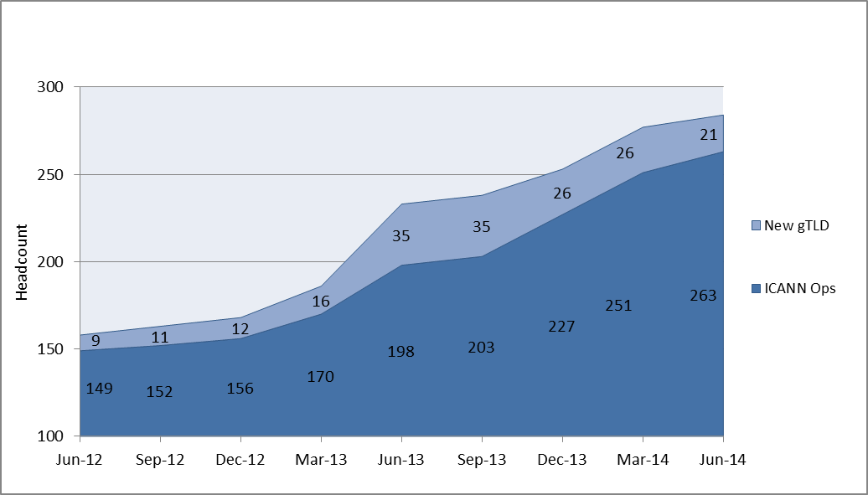
FY14 Draft Operating Plan & Budget Headcount Growth

Slide 25
FY14 Draft Operating Plan
and Budget
Management Delivery

Slide 26
Management Delivery: Objectives & Goals
w. FY14 Draft Budget
DELIVER CORE INTERNAL FUNCTIONS
ACT AS STEWARD OF PUBLIC INTEREST
ENGAGE IN IG ECOSYSTEM
DEEPEN PARTNERSHIP WITH I-ORGS.
$15.6M
INSTITUTIONALIZE MGMT. DISCIPLINES
MATURE ORG. SUPPORT FUNCTIONS
OPTIMIZE R&R SERVICES
PLAN FOR SCALE, SECURITY, CONTINUITY
$106.4M
(of which $57.6M is related to the New gTLD program)
1
AFFIRMATION OF PURPOSE
2
OPERATIONS EXCELLENCE
3
INTERNATIONALIZATION
4
MULTI
STAKE
HOLDER
ENGAGE STAKEHOLDERS GLOBALLY
COMMUNICATE CLEARLY & LOCALLY
INTEGRATE GLOBAL/REGIONAL RESP.
EVOLVE GOV. RELATIONSHIPS
$11.9M
MODEL EVOLUTION
OPTIMIZE POLICY DEV. PROCESS
INCREASE/IMPROVE PARTICIPATION
EVOLVE SO/AC STRUCTURES
PROMOTE ETHICS & TRANSPARENCY
$8.2M

Slide 27
Management Delivery: AtTask Structure Overview
OBJECTIVES
GOALS
PORTFOLIOS
PROGRAMS
Core foundational strategies upon which measurable targets are based
Desired achievable outcome to meet an organization-wide objective
Cross-functional work undertaken in support of goals to fulfill core deliver-ables and services
Group of inter-dependent projects/ activities managed in a coordinated way to obtain benefits
Status Key: (Status is measured against expected completion dates)
On Target Project dates are on track to meet the estimated planned completion date
At Risk Project dates are tracking behind the estimated planned completion date
In Trouble Project dates are tracking late the estimated planned completion date
Complete Project is completed
Description – a detailed definition of the scope of work
Owner – name identified with each entry that is responsible for the work at ICANN
Timeline – target date designated for completion or, for ongoing work for the current fiscal year (e.g. FY13T3)
Metric – description of quantifiable measurement(s) of success
Priority – indicates level of priority within the fiscal year (e.g. Urgent, High, Normal and Low)
Dependencies – resource or activity that is critical to the success for completing the work
Risks – factors that may have a negative impact on successful completion of the work
Stakeholders – parties who are either interested or impacted by the work
ICANN transitioned to this centralized Portfolio Management System in January 2013. Work is still ongoing to develop consistency and uniformity to the system.
Information found in the ICANN Portfolio Management System will be continually updated. It is an information source for informal reference only.
It should not be used as an official source of information about ICANN or its work.

Slide 28
FY14 Draft Operating Plan & Budget – AtTask (In thousands)

Slide 29
FY14 Draft Operating Plan & Budget – AtTask (In thousands)

Slide 30
FY14 Draft Operating Plan & Budget – AtTask (In thousands)

Slide 31
FY14 Draft Operating Plan & Budget – AtTask (In thousands)

Slide 32
FY14 Draft Operating Plan & Budget – AtTask (In thousands)

Slide 33
FY14 Draft Operating Plan
and Budget
Community Requests

Slide 34
FY14 Draft Operating Plan & Budget – Community Support Requests (In thousands)

Slide 35
FY14 Draft Operating Plan & Budget – Community Support Requests

Slide 36
FY14 Draft Operating Plan & Budget – Community Support Requests cont.

Slide 37
FY14 Draft Operating Plan
and Budget
New gTLD Program

Slide 38
New gTLD Program – Financial Summary (In thousands)

Slide 39
New gTLD Program – Financial Summary (In thousands)

Slide 40
New gTLD Program – Operating Expenses (In thousands)

Slide 41
New gTLD Program – Expense Variance Analysis
(In thousands)

Slide 42
New gTLD Program – Multi-Year View (In thousands)

Slide 43
Appendix

Slide 44
Table 1.0 (In thousands)

Slide 45
Thank You

